Slide 1
sdmay19-17:
Burns and McDonnell Substation Design
Tom Kelly, Connor Mislivec, Jake Heiller, Rebecca Franzen,
Wilson Pietruszewski, Riley O’Donnell

Slide 2
Client Overview
Engineer-architect-contractor consulting firm
Headquartered in Kansas City, Missouri
Notes:
Been working with Grant Hermann
Bi-weekly meetings on the phone
Next semester will be working with Thanh Nguyen and Zach Porter
Burns and McDonnell: client and advisor
Consulting firm: many specs given to us by client
What is consulting?
Providing design phase services for cyclone substation -- interconnection for a new wind farm being built in the area
Physical construction is contracted out.

Slide 3
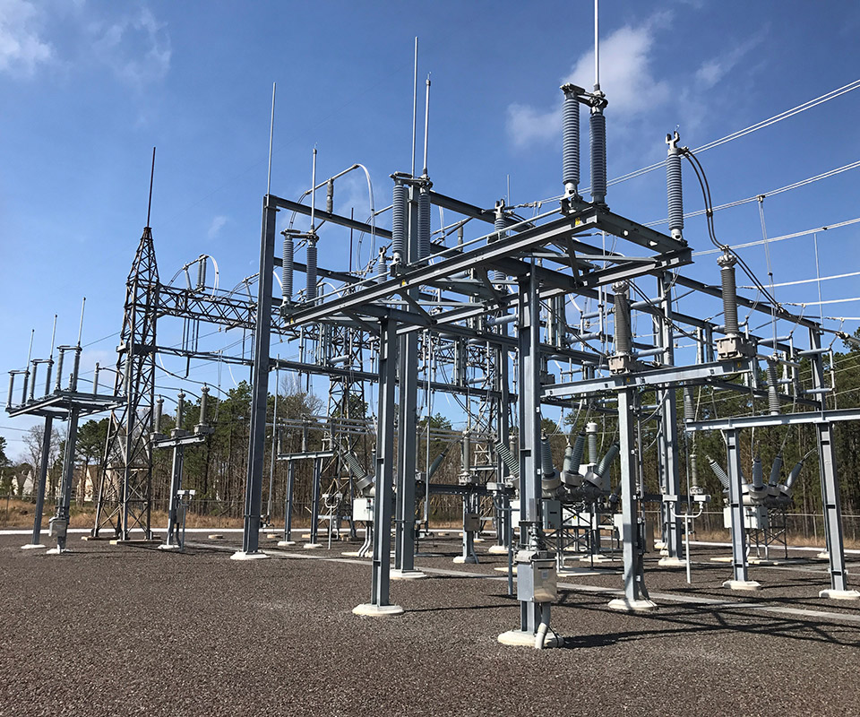
Problem Statement
General problem
High voltage distribution is unsafe
Unable to transmit power long distances
Our solution
Design 138/69 kV greenfield substation
Regulate voltage levels in/out
Ring bus configuration
http://gannettfleming.com/Projects/2015/10/19/11/29/mill-electrical-substation-upgrade

Slide 4
Conceptual Sketch
Line to Cedar Falls
138/69 kV XFMR
69 kV Breaker
Line to Des Moines
138 kV Breakers
Notes:
Talk about how we preliminarily came up with the layout for the substation and how we proceeded to design the substation afterwards

Slide 5
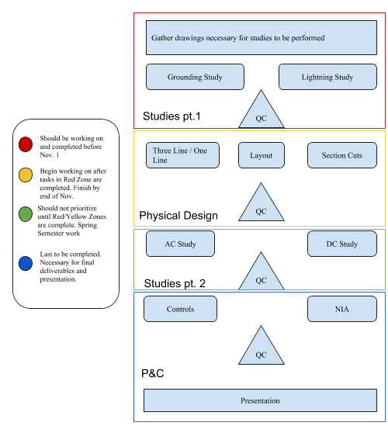
System Block Diagram
Studies pt. 1
Physical Design
Studies pt. 2
P&C
Notes:
Talk about how our project is unique and we have already completed part of the design

Slide 6
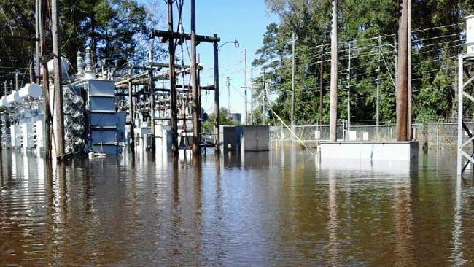
Operating Environment
Built to last
Withstand regional weather extremes
Notes:
Add image of old substation versus new substation

Slide 7
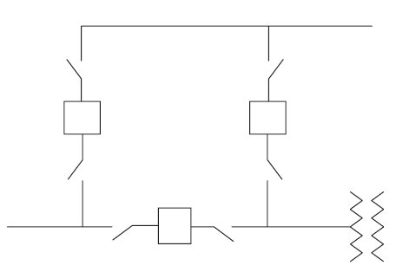
Technical/Other Constraints/Considerations
Three 138 kV Circuit Breakers
One 69 kV Circuit Breaker
One 138/69 kV Transformer
Ring Bus Configuration
Future “Breaker-and-a-half” Scheme
Two transmission lines entering/exiting substation
Grounding System withstand 21 kA Fault Current
Site Size of 400’ x 400’
http://eblogbd.com/detils-air-insulated-substations-bus-switching-configurations/

Slide 8
Functional Requirements
Site Design & Substation Layout
Bus & Insulator Sizing Design
Ground Grid & Lightning Protection
Raceway
Control Building
125VDC Station Battery Design
Relaying & Controls
Communications
Notes:
Refer to BMcD’s Scope of Services document, Refer to IEEE documents that are or will be used 998, 485, 80

Slide 9
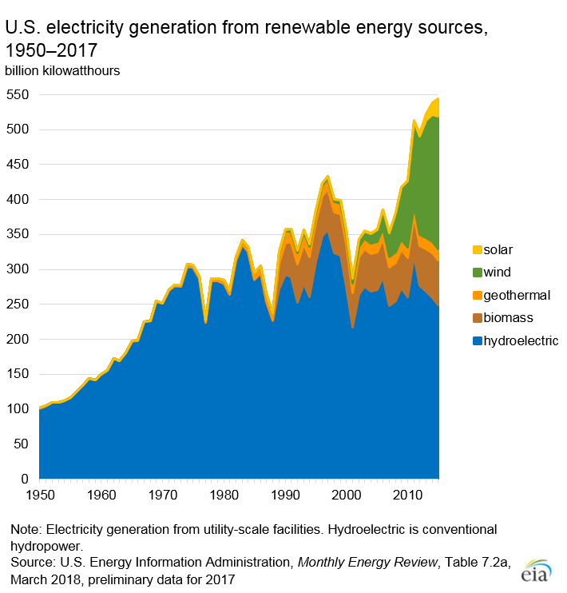
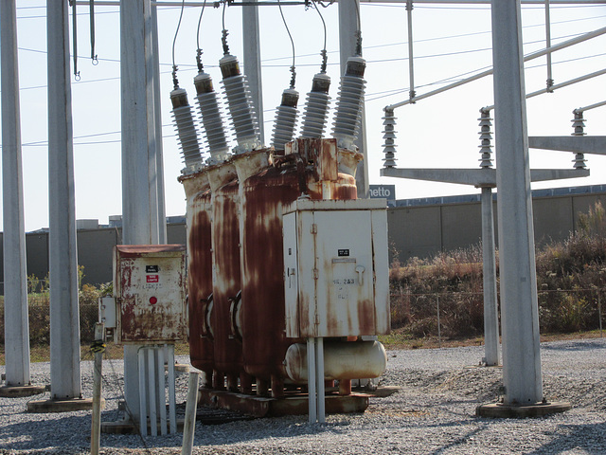
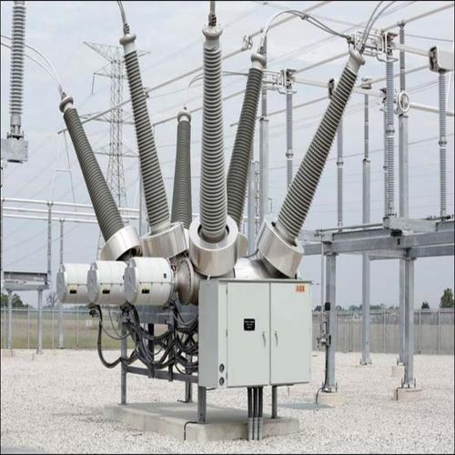
Market Survey
Upward trend in energy consumption
New technology for protection
Infrastructure attacks
Reducing blackouts
Substations are becoming outdated
Need for system upgrade
Notes:
Graph of US electrical energy consuption
Image of old vs new substation
Federal energy regulatory commision
North American Energy Reliability Corporation

Slide 10
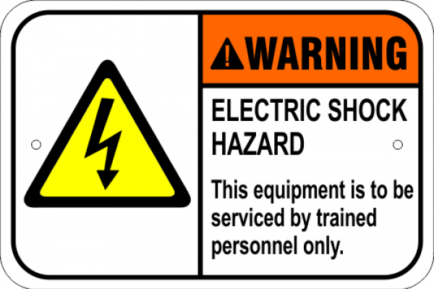
Potential Risks and Mitigation
Potential Electric Shock due to Fault Current
Grounding System designed to provide safe environment to those within the vicinity of the substation.
Lightning Protection Design to provide protective layer over major equipment
Faulty testing software

Slide 11
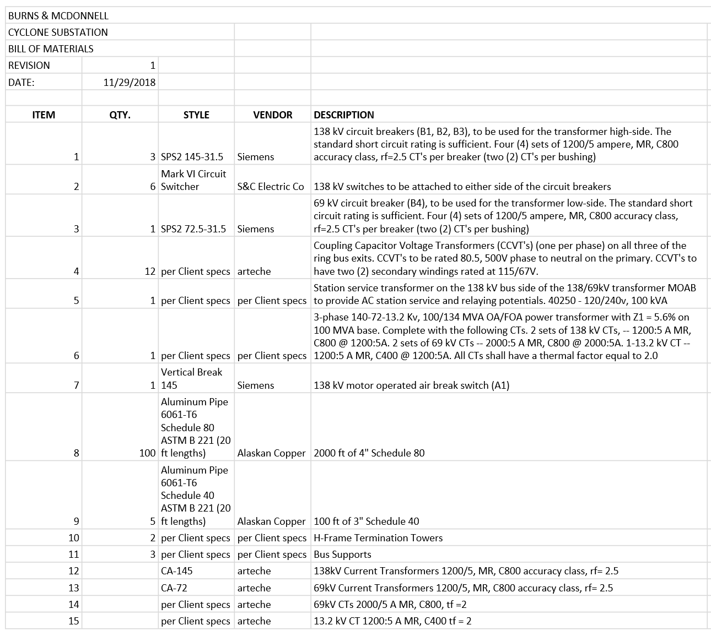
Resource Estimate

Slide 12
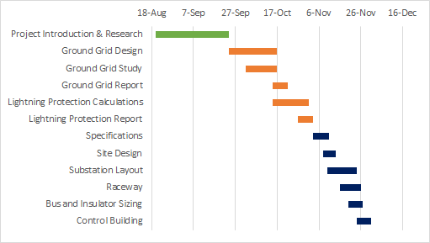
Schedule: Semester 1
3 deliverables
Grounding design- November 2
Lightning Protection Design- November 2
Physical Design- November 30

Slide 13
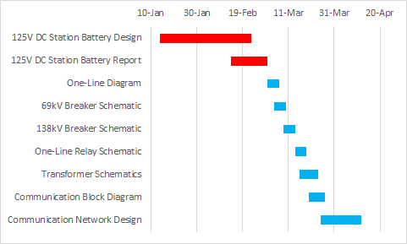
Schedule: Semester 2
2 deliverables
AC/DC Studies- March 1
Controls and NIA- April 12

Slide 14
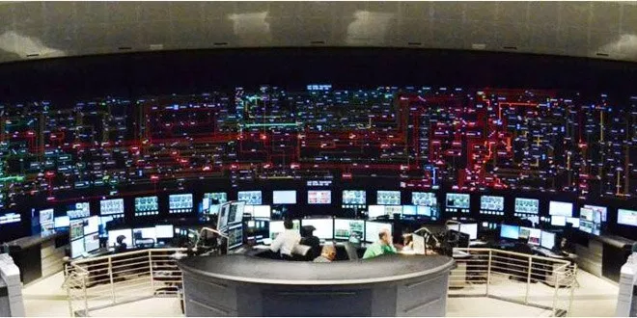
User Interface Description
Communications systems
Service Centers
Centers for Data Aggregation and Grid power control

Slide 15
Functional Decomposition
Physical Design Package
Grounding System Design
Lightning Protection Design
Physical Design Drawings
Preliminary Grounding Design
Physical Drawing Plans
Plan View
Elevation Views
Update Grounding Design based on Plan View
Include major equipment
Lightning Protection Study
Physical Lightning Protection Plan Drawing

Slide 16
Software Programs used
CDEGS- (Current Distribution, Electromagnetic Interference, Grounding and Soil Structure Analysis)- Grounding (earthing) and electromagnetic analysis software package; used in ground grid design process.
AutoCAD- Computer-Aided design and drafting software; used in the creation of physical drawings.

Slide 17
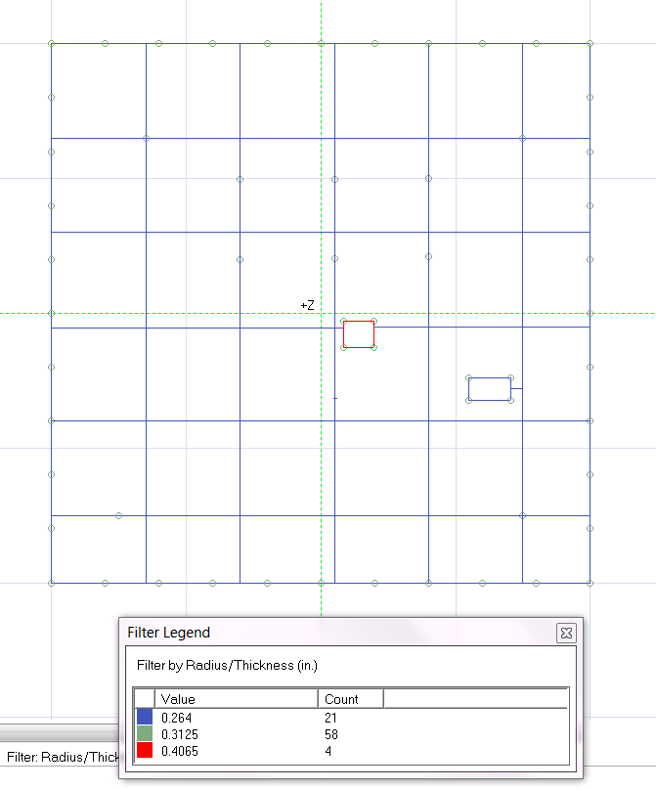
Detailed Design (Grounding System Design)

Slide 18
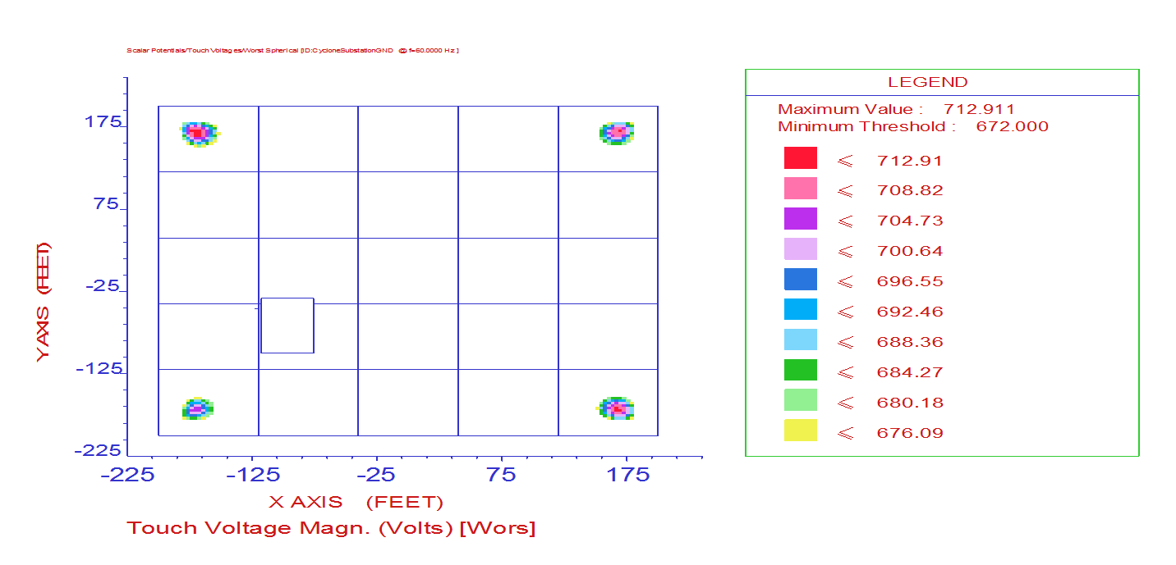
Testing
Notes:
Talk about rocks

Slide 19
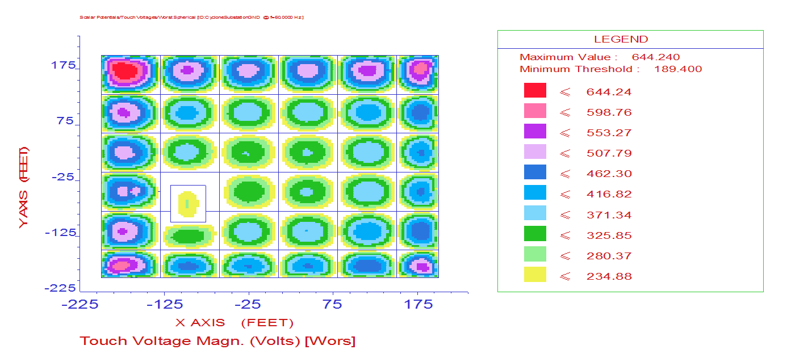
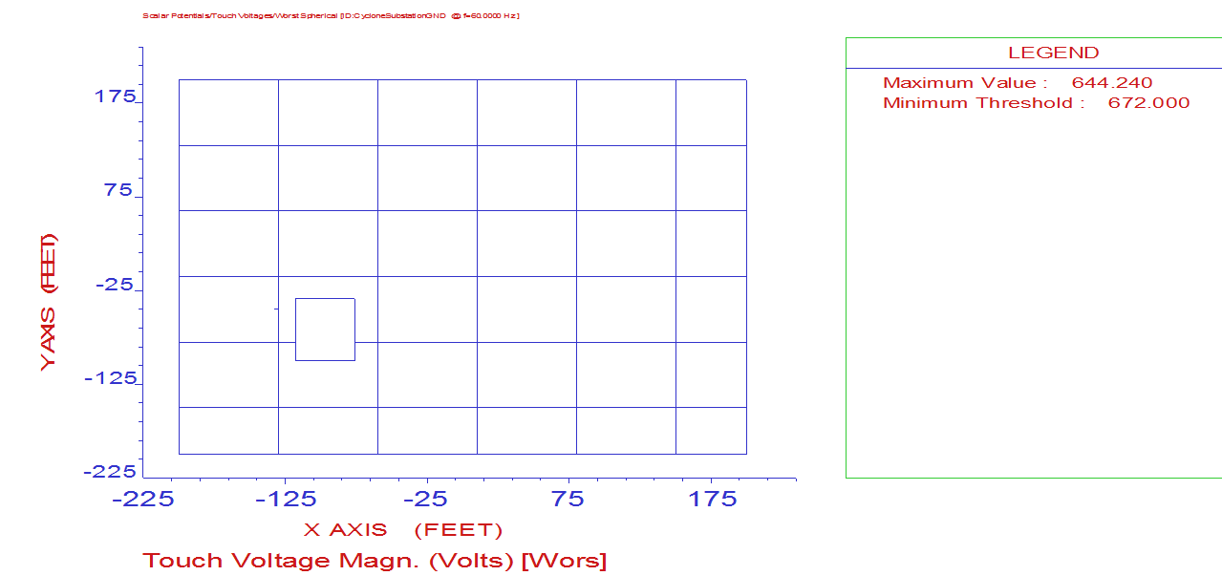
Testing Continued

Slide 20
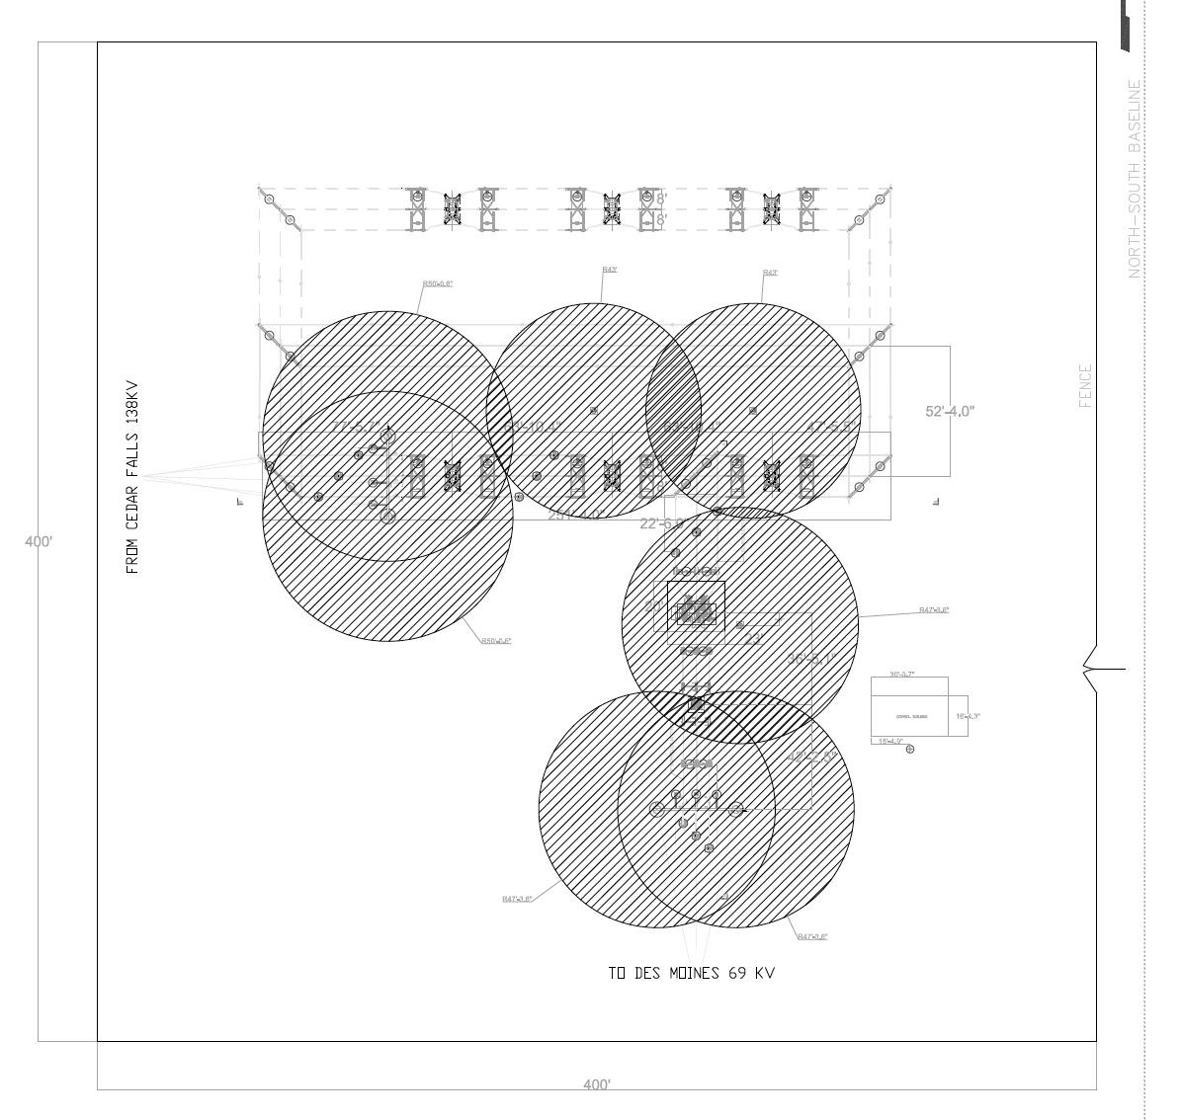
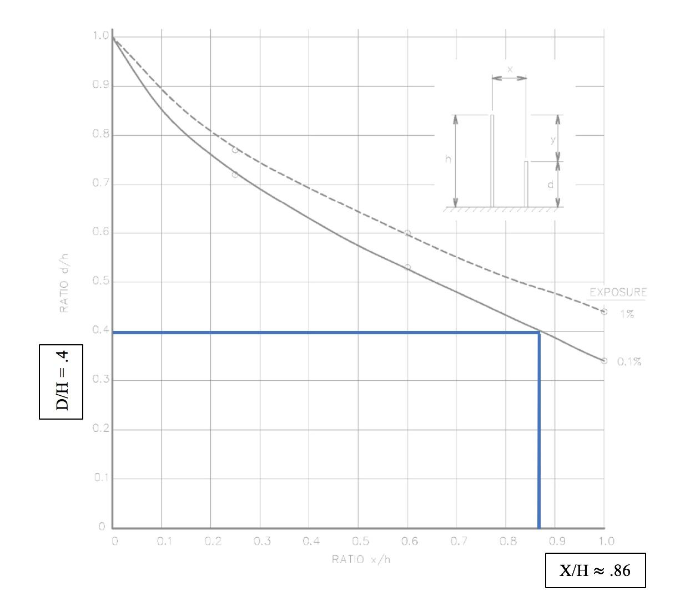
Detailed Design (Lightning Protection)
Notes:
Protection of an exposed object by a single lightning mast

Slide 21
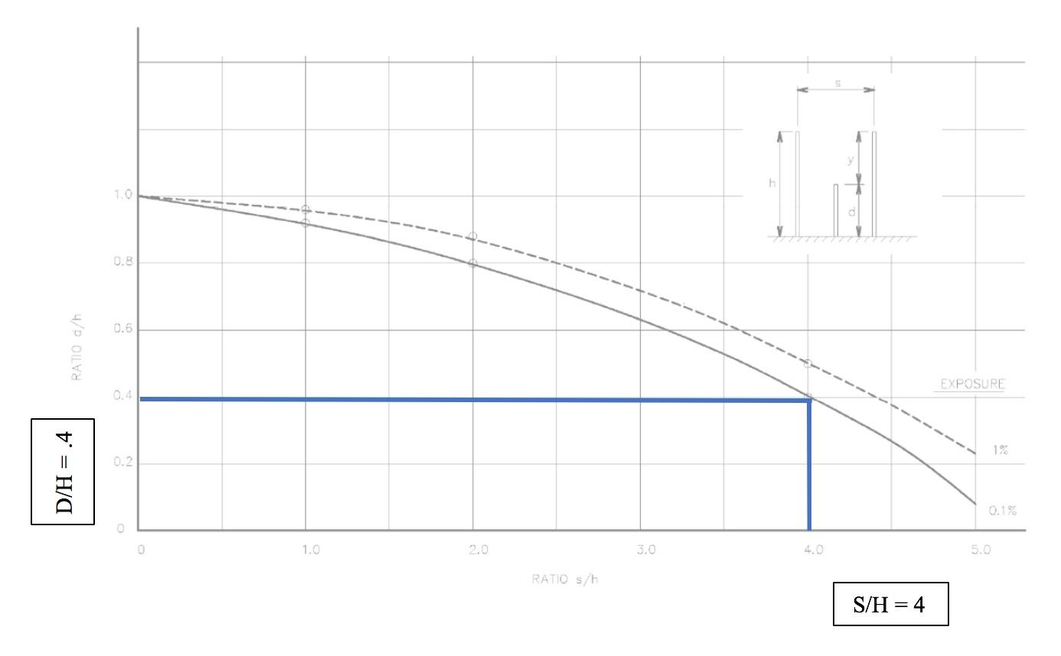
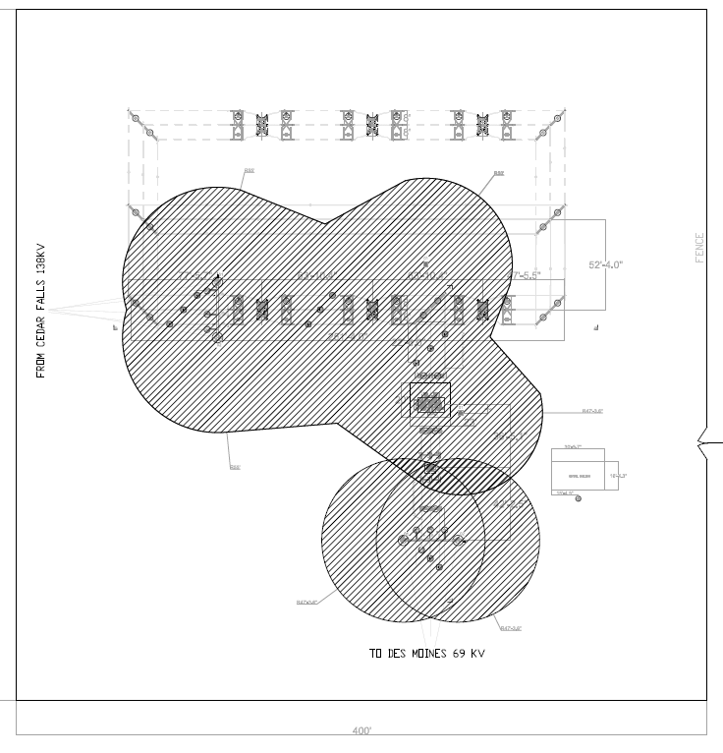
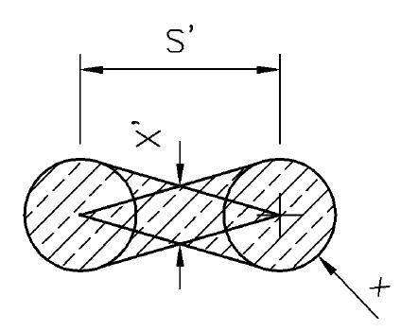
Detailed Design (Lightning Protection)
Notes:
Protection of an exposed object by two lightning masts

Slide 22
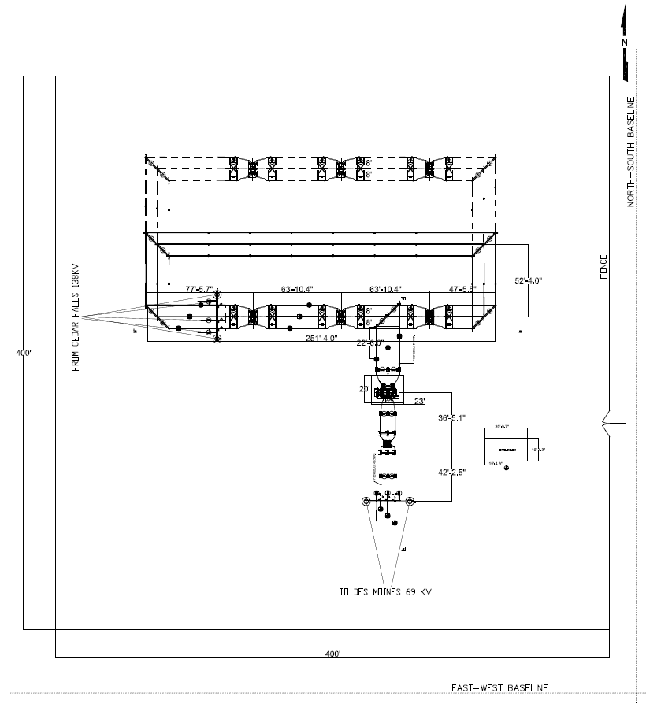
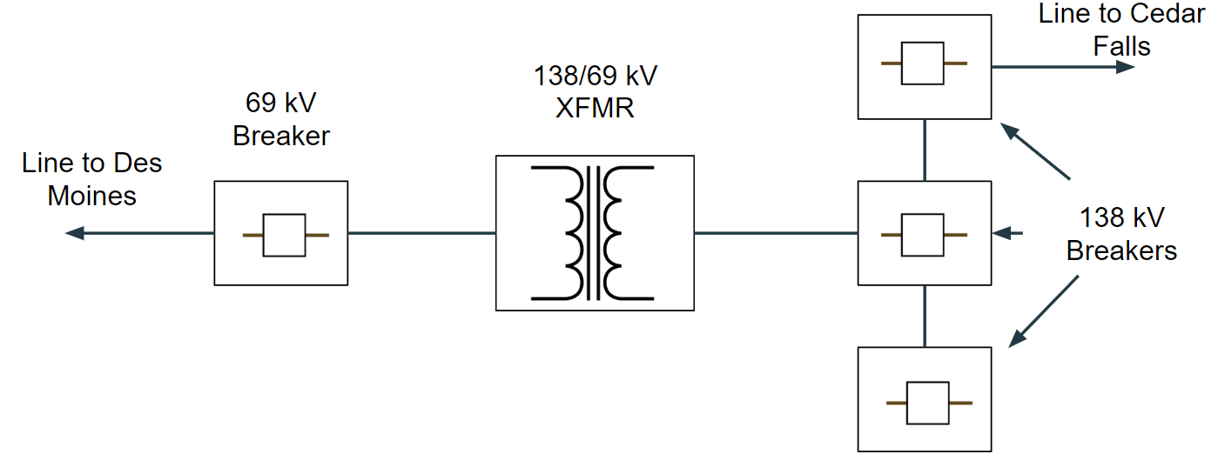
Detailed Design (Physical Design)

Slide 23
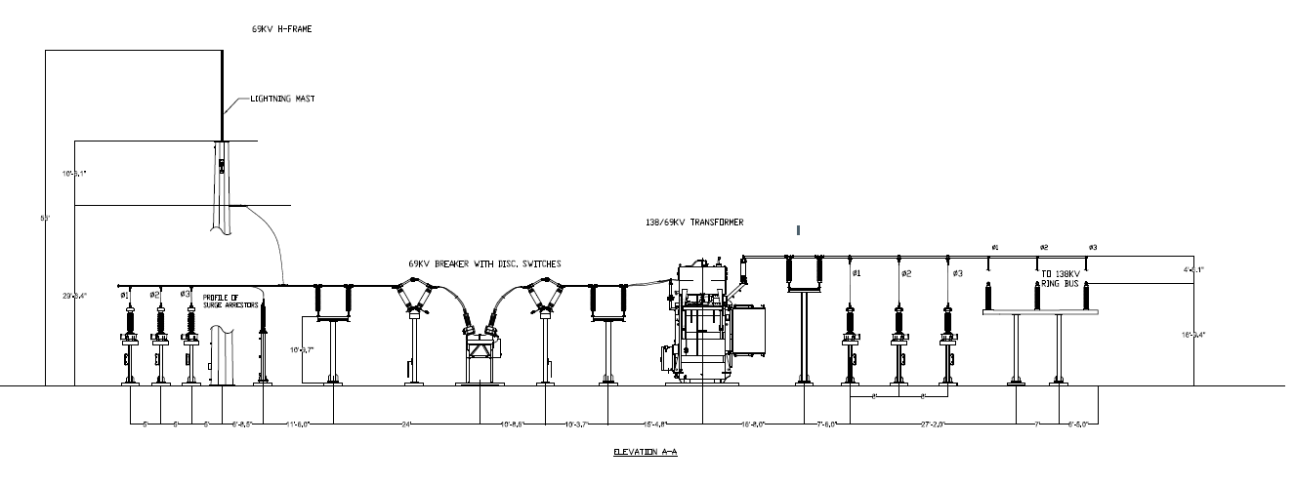
Detailed Design (Elevation A-A)

Slide 24
Detailed Design (Elevation B-B)

Slide 25
Project Status
Submitted deliverables to client on November 30
Physical Design Package
Grounding Design Package
Lightning Protection Design Package

Slide 26
Plan for next semester
AC/DC Studies
Battery Sizing
Relaying and Controls
Protection schematics and wiring diagrams
Communications
Fiber communications between substations

